Slide 1
Basics of NLP: TF-IDF
TF-IDF: Measuring Word Importance
TF-IDF stands for Term Frequency-Inverse Document Frequency. It's a numerical statistic used to evaluate how important a word is to a specific document within a collection of documents (a corpus).
Term Frequency (TF): Measures how often a word appears in a single document. A word that appears many times has a higher TF.
Inverse Document Frequency (IDF): Measures how common or rare a word is across all documents. Common words (like "data") will have a low IDF score, while rare, specialized words will have a high IDF score.

Slide 2
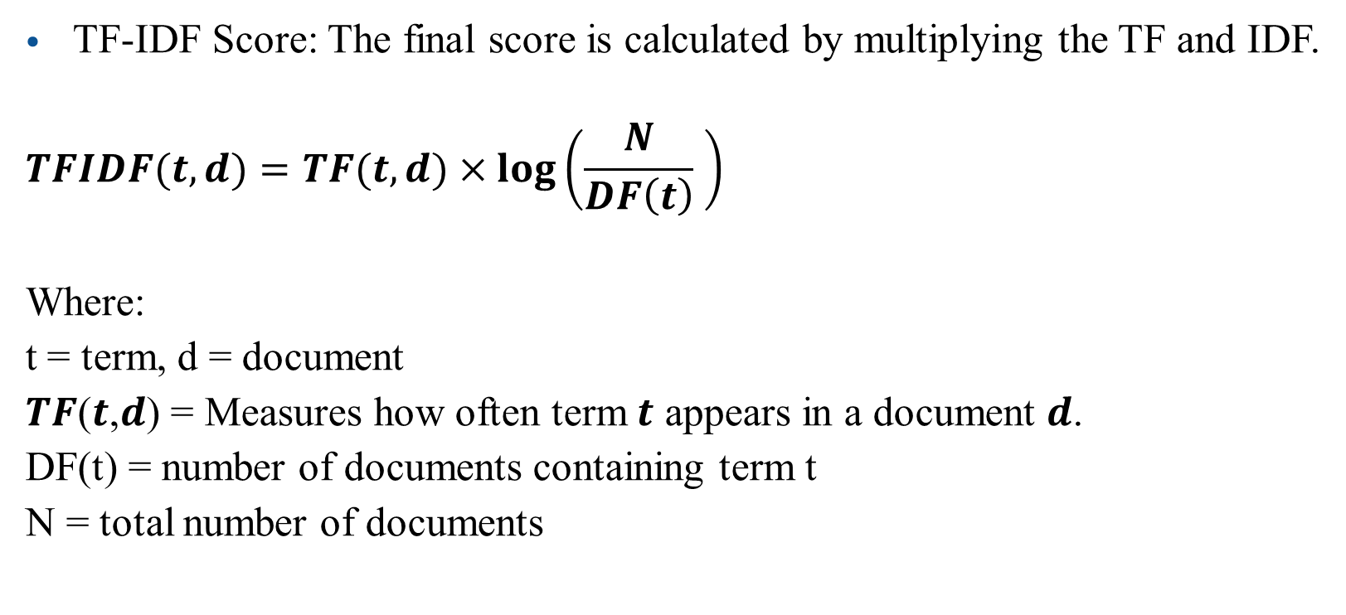
Basics of NLP: TF-IDF

Slide 3
Basics of NLP: TF-IDF
Step-by-Step TF-IDF Example
Sample Corpus
Let's say we have the following two documents:
Document 1 (D1): "Data science is fun“
Document 2 (D2): "Data science is powerful"

Slide 4
Basics of NLP: TF-IDF
Step-by-Step TF-IDF Example
Step 1: Preprocess the Text
Lowercase all words
Remove punctuation (if any)
Tokenize (split into words)
After preprocessing:
D1: ["data", "science", "is", "fun"]
D2: ["data", "science", "is", "powerful"]

Slide 5
Basics of NLP: TF-IDF
Step-by-Step TF-IDF Example
Step 2: Term Frequency (TF)
Calculate how often each term appears in a document.
D1: ["data", "science", "is", "fun"]
D2: ["data", "science", "is", "powerful"]
In this case, each word appears only once in each document, so raw term frequency = 1 (or 0 if absent).
Term | TF in D1 | TF in D2
data | 1/4 | 1/4
science | 1/4 | 1/4
is | 1/4 | 1/4
fun | 1/4 | 0
powerful | 0 | 1/4

Slide 6
Basics of NLP: TF-IDF
Step-by-Step TF-IDF Example
Step 3: Document Frequency (DF)
Number of documents in which each term appears.
D1: ["data", "science", "is", "fun"]
D2: ["data", "science", "is", "powerful"]
Term | TF in D1 | TF in D2
data | 1/4 | 1/4
science | 1/4 | 1/4
is | 1/4 | 1/4
fun | 1/4 | 0
powerful | 0 | 1/4
Term | DF
data | 2
science | 2
is | 2
fun | 1
powerful | 1

Slide 7
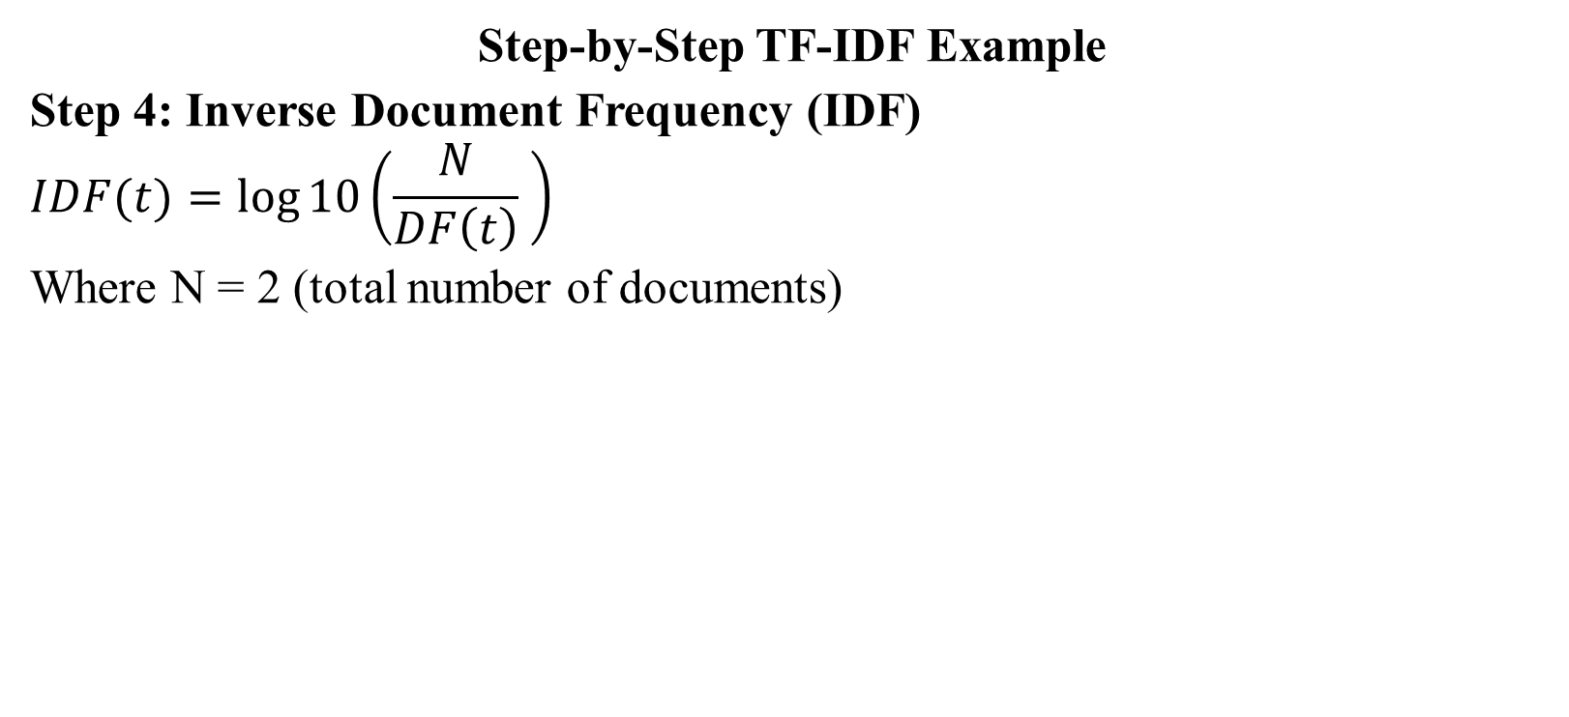
Basics of NLP: TF-IDF
Term | TF in D1 | TF in D2
data | 1/4 | 1/4
science | 1/4 | 1/4
is | 1/4 | 1/4
fun | 1/4 | 0
powerful | 0 | 1/4
Term | DF
data | 2
science | 2
is | 2
fun | 1
powerful | 1
Term | IDF | Value
data | log10(2/2) = log10(1) | 0.00
science | log10(2/2) = log10(1) | 0.00
is | log10(2/2) = log10(1) | 0.00
fun | log10(2/1) = log10(2) | ≈ 0.3010
powerful | log10(2/1) = log10(2) | ≈ 0.3010

Slide 8
Basics of NLP: TF-IDF
Term | TF in D1 | TF in D2
data | 1/4 | 1/4
science | 1/4 | 1/4
is | 1/4 | 1/4
fun | 1/4 | 0
powerful | 0 | 1/4
Step-by-Step TF-IDF Example
Step 5: TF × IDF
Now multiply TF with IDF for each term in each document:
Term | TF-IDF in D1 | TF-IDF in D2
data | 1/4 × 0 = 0 | 1/4 × 0 = 0
science | 1/4 × 0 = 0 | 1/4 × 0 = 0
is | 1/4 × 0 = 0 | 1/4 × 0 = 0
fun | 1/4 × 0.301 = 0.075 | 0 × 0.301 = 0
powerful | 0 × 0.301 = 0 | 1/4 × 0.301 = 0.075
Term | IDF Value
data | 0.00
science | 0.00
is | 0.00
fun | ≈ 0.3010
powerful | ≈ 0.3010

Slide 9
Basics of NLP: TF-IDF
Term | TF in D1 | TF in D2
data | 1/4 | 1/4
science | 1/4 | 1/4
is | 1/4 | 1/4
fun | 1/4 | 0
powerful | 0 | 1/4
Common words like "data", "science", and "is" have TF-IDF = 0 because they appear in all documents (not informative).
Unique words like "fun" and "powerful" have higher TF-IDF values, making them more important for distinguishing between the documents.
Term | TF-IDF in D1 | TF-IDF in D2
data | 0 | 0
science | 0 | 0
is | 0 | 0
fun | 0.075 | 0
powerful | 0 | 0.075
Term | Value
data | 0.00
science | 0.00
is | 0.00
fun | ≈ 0.3010
powerful | ≈ 0.3010

